Slide 1
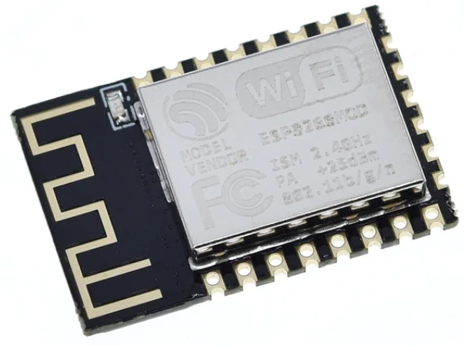
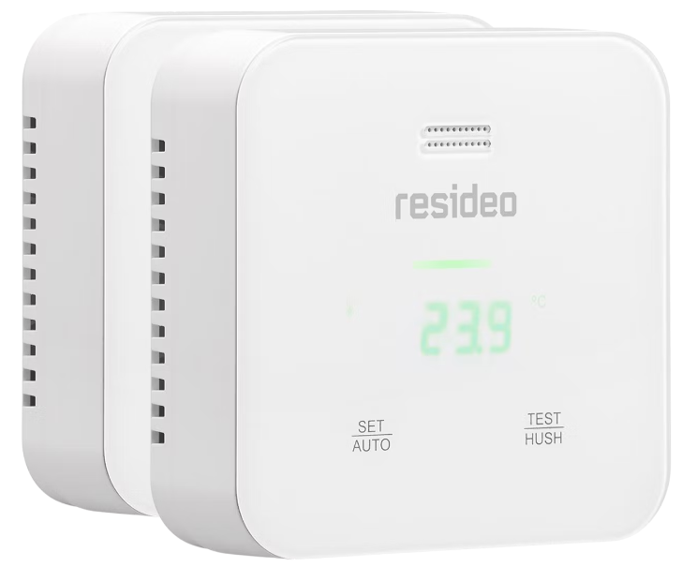
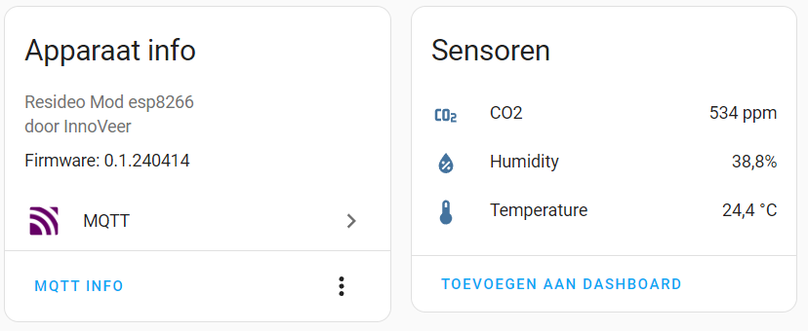

Slide 2
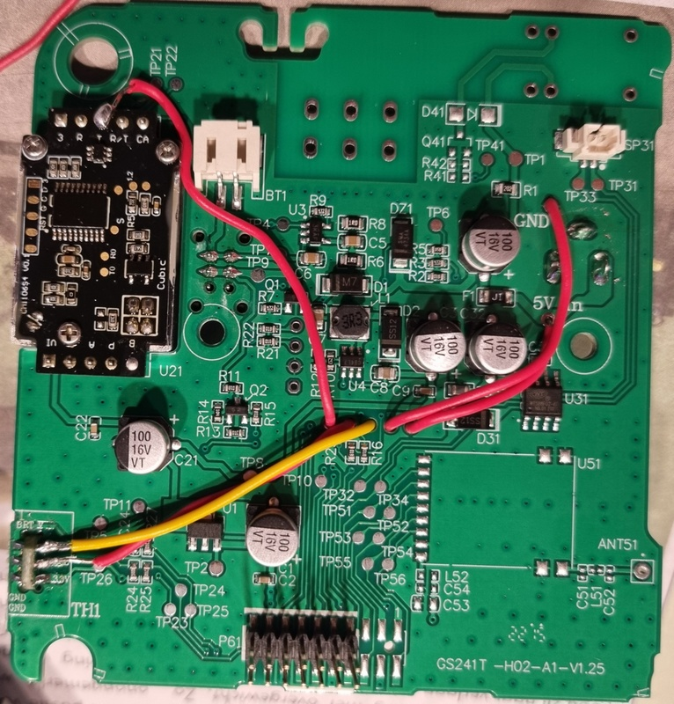
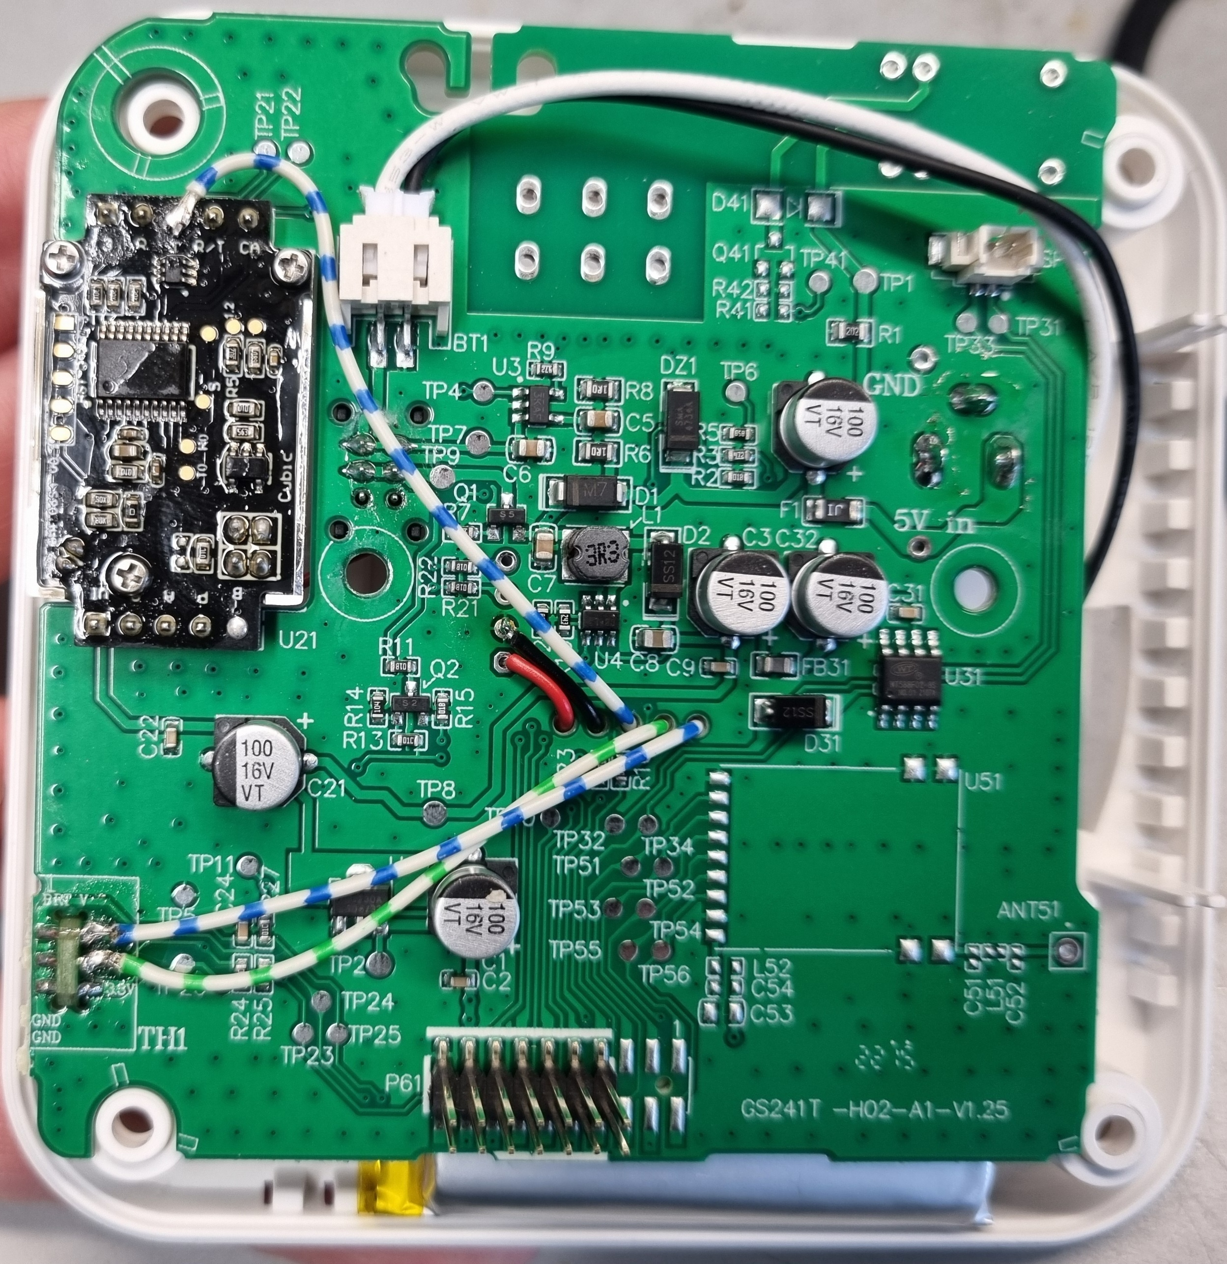
https://gathering.tweakers.net/forum/list_message/78427188#78427188
5V
3.3V

Slide 3
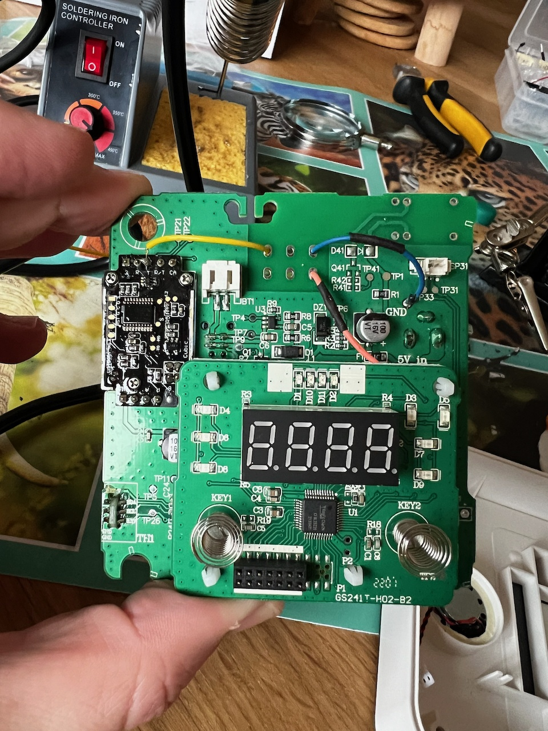
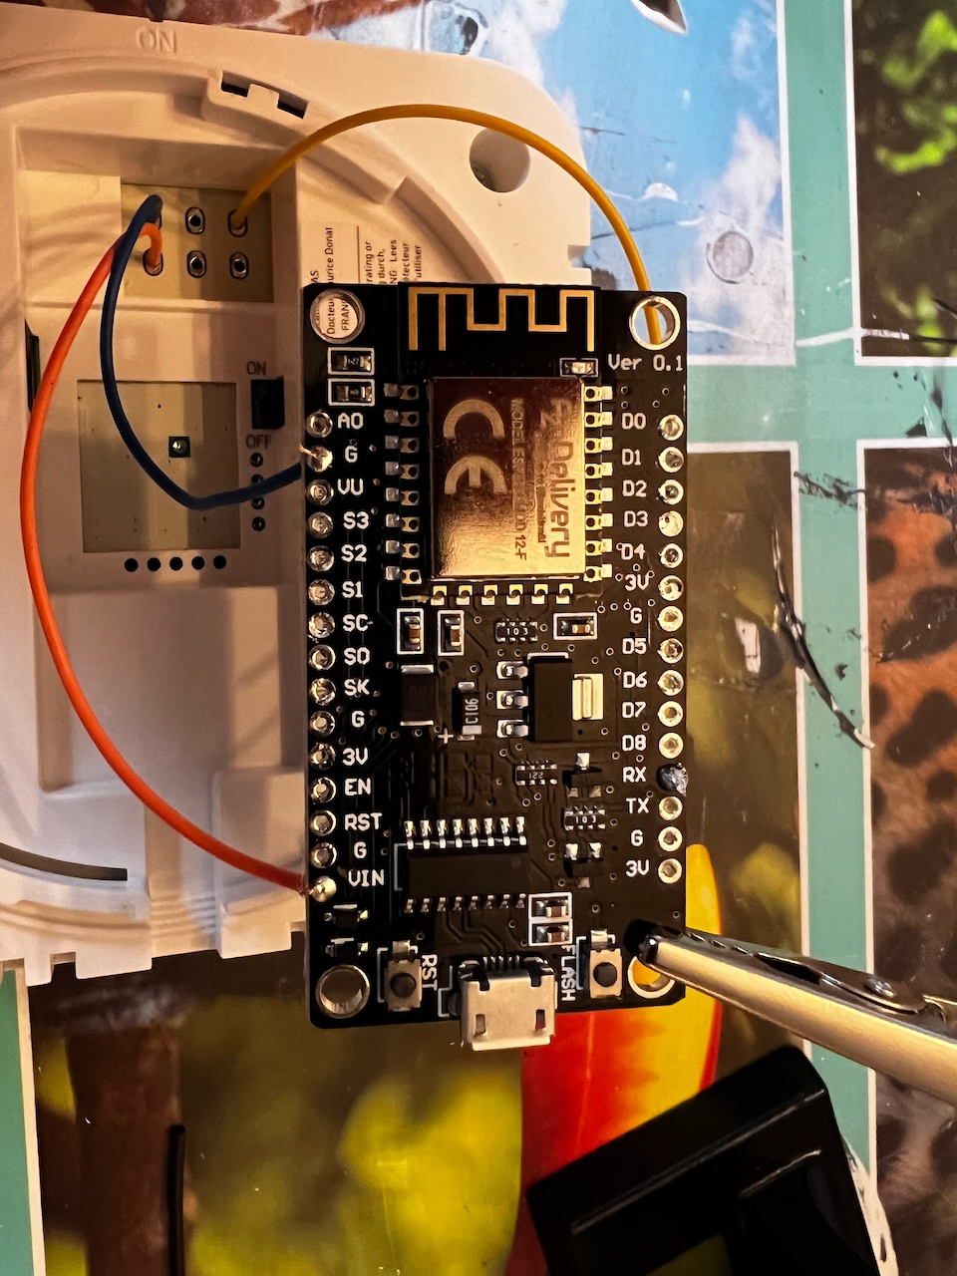
https://gathering.tweakers.net/forum/list_message/77882454#77882454
ESP8266 parallel aan CH430

Slide 4
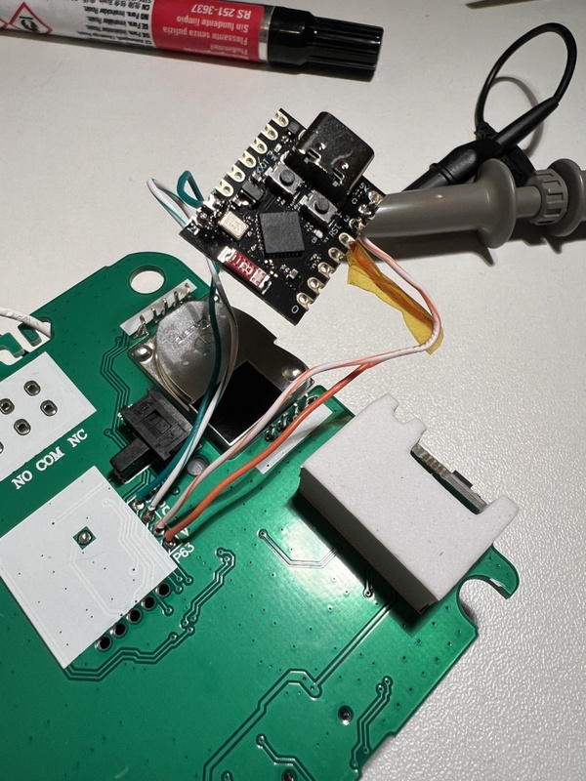
https://gathering.tweakers.net/forum/list_message/78228570#78228570
Code
https://gathering.tweakers.net/forum/list_message/78236480#78236480
V = 3,3V op de ESP32 G = Ground D = pin 20 (RX op de ESP) C = pin 21 (TX op de ESP)

Slide 5
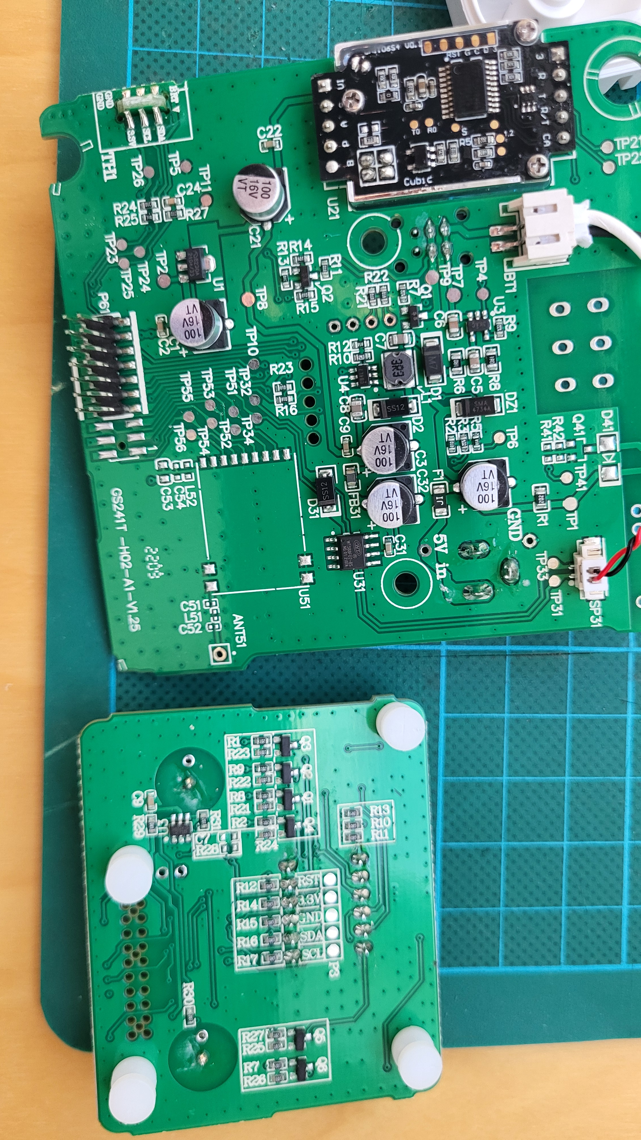
SDA
D = TXCO2
C = RXCO2
G = Ground V = 3,3V
SCL

Slide 6
https://gathering.tweakers.net/forum/list_message/78586134#78586134
https://github.com/rhmswink/Resideo-R200C2-ESPHome-Mod/tree/main
https://github.com/rhmswink/Resideo-R200C2-ESPHome-Mod/blob/main/Source/cm1106_sensor.h

Slide 7
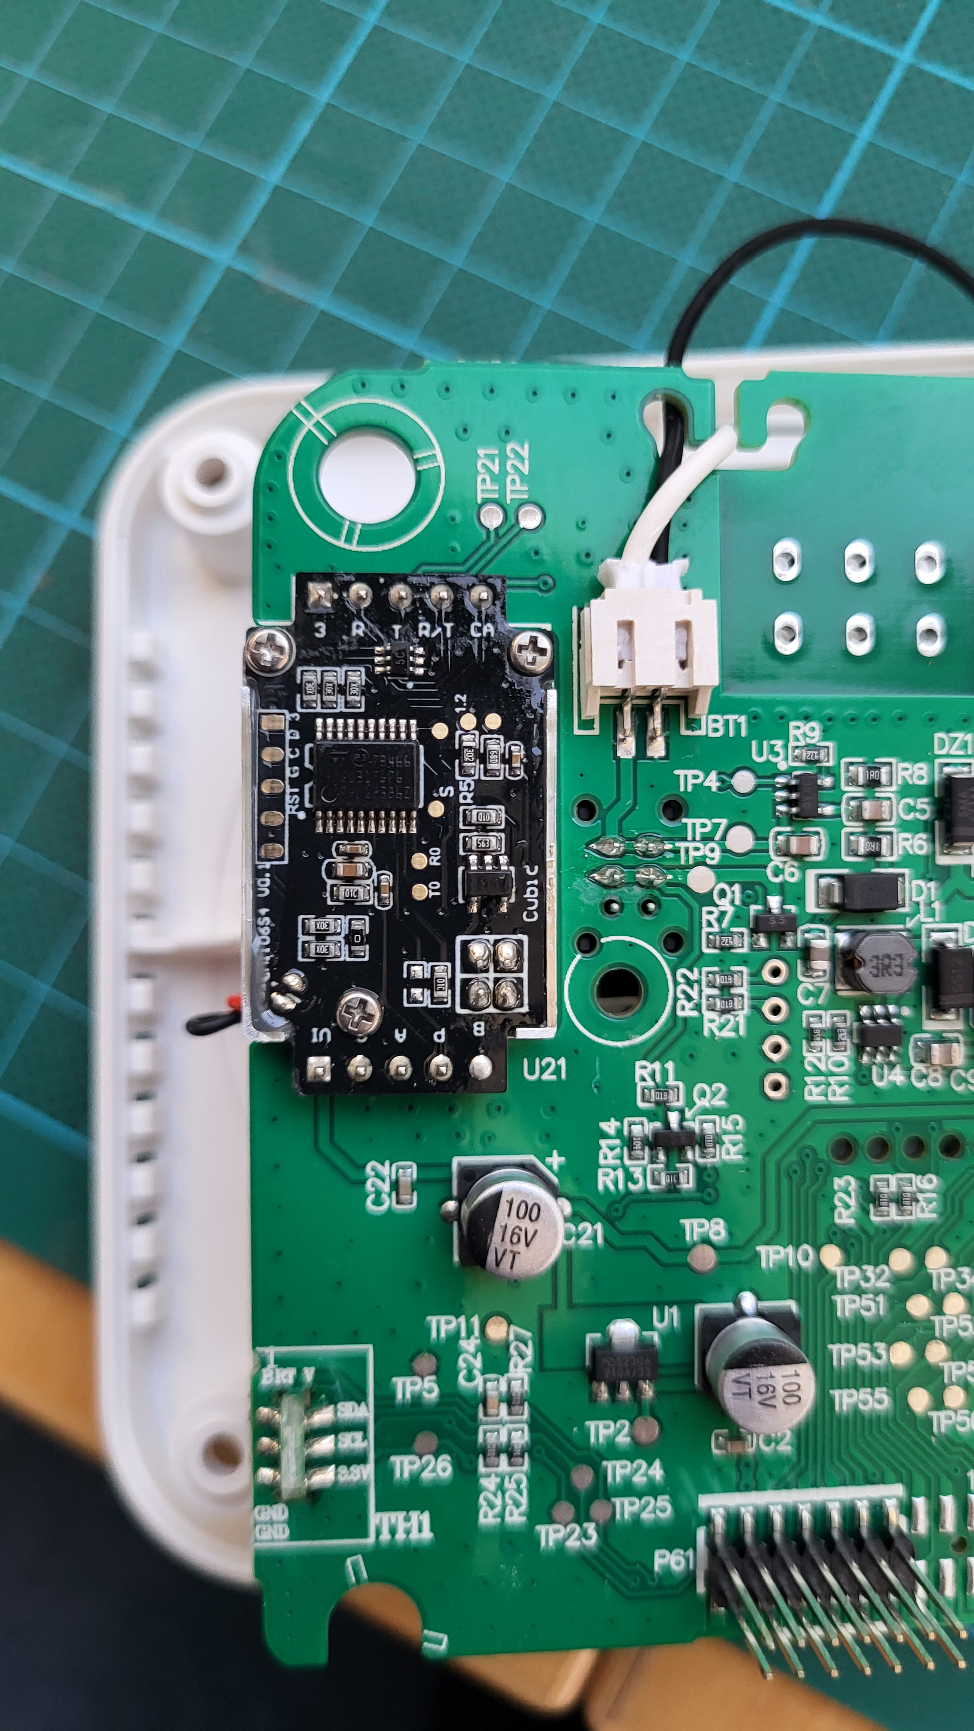
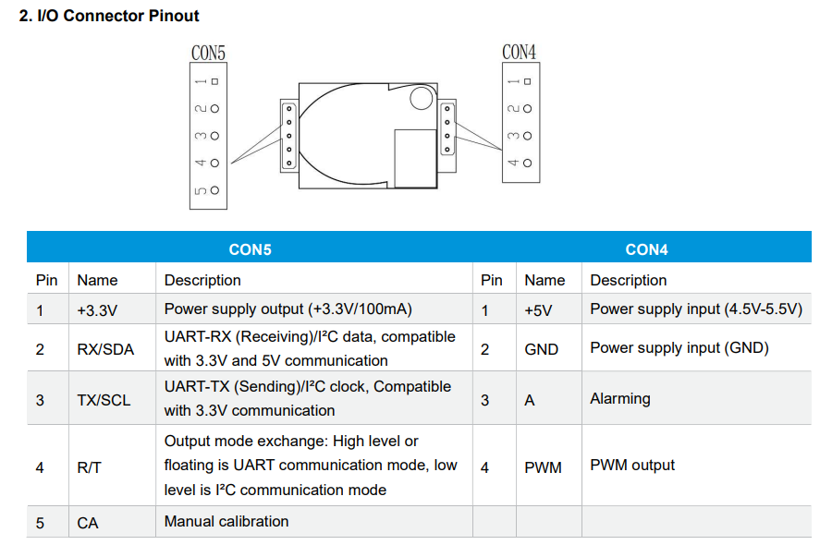
Cubic CO2 Sensor
https://en.gassensor.com.cn/Product_files/Specifications/CM1106-C%20Single%20Beam%20NDIR%20CO2%20Sensor%20Module%20Specification.pdf
CON5: 1 2 3 4 5
nc x x nc x
CON4: 1 2 3 4
5 G nc nc

Slide 8
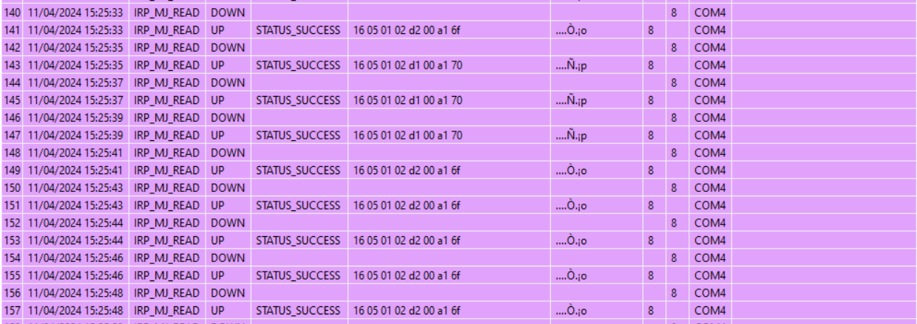
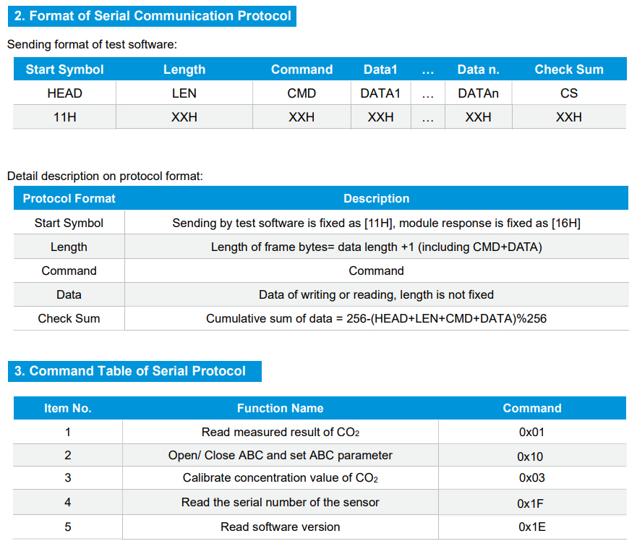
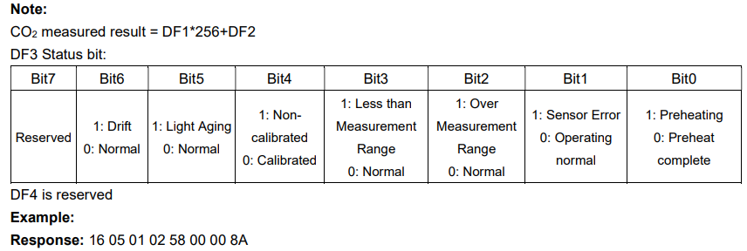
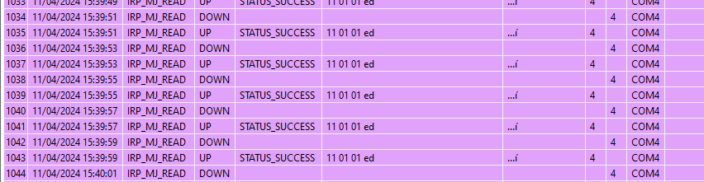
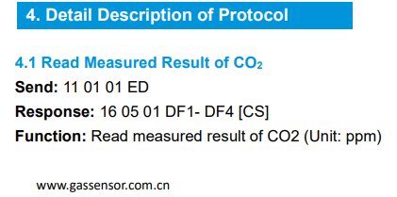
Resideo Controller port
RX
TX
SCL
SDA
D - TX
C - RX
GND
V +3.3

Slide 9
Resideo Controller port
RX
TX
SCL
SDA
D - TX
C - RX
GND
V +3.3

Slide 10
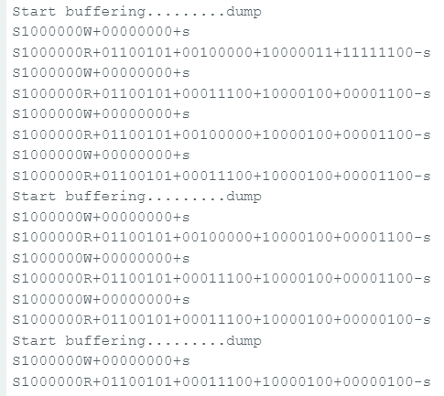
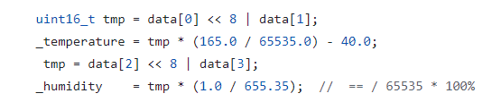
Temp/Humidity sensor
https://github.com/RobTillaart/CHT8305
S 1000000 W + 00000000 + s
Address: 0x40 Start register: 0x00 (temp)
S 1000000 R + 01100100 + 10000000 + 10000100 + 10110000 – s
Address: 0x40 Read 4 bytes (0x64, 0x80, 0x84, 0xB0)
S1000000W+00000000+s
S1000000R+01100100+10000000+10000100+10110000-s
S1000000W+00000000+s
S1000000R+01100100+10000000+10000100+10110000-s
0x6480 = 25728
24.7 grd

Slide 11
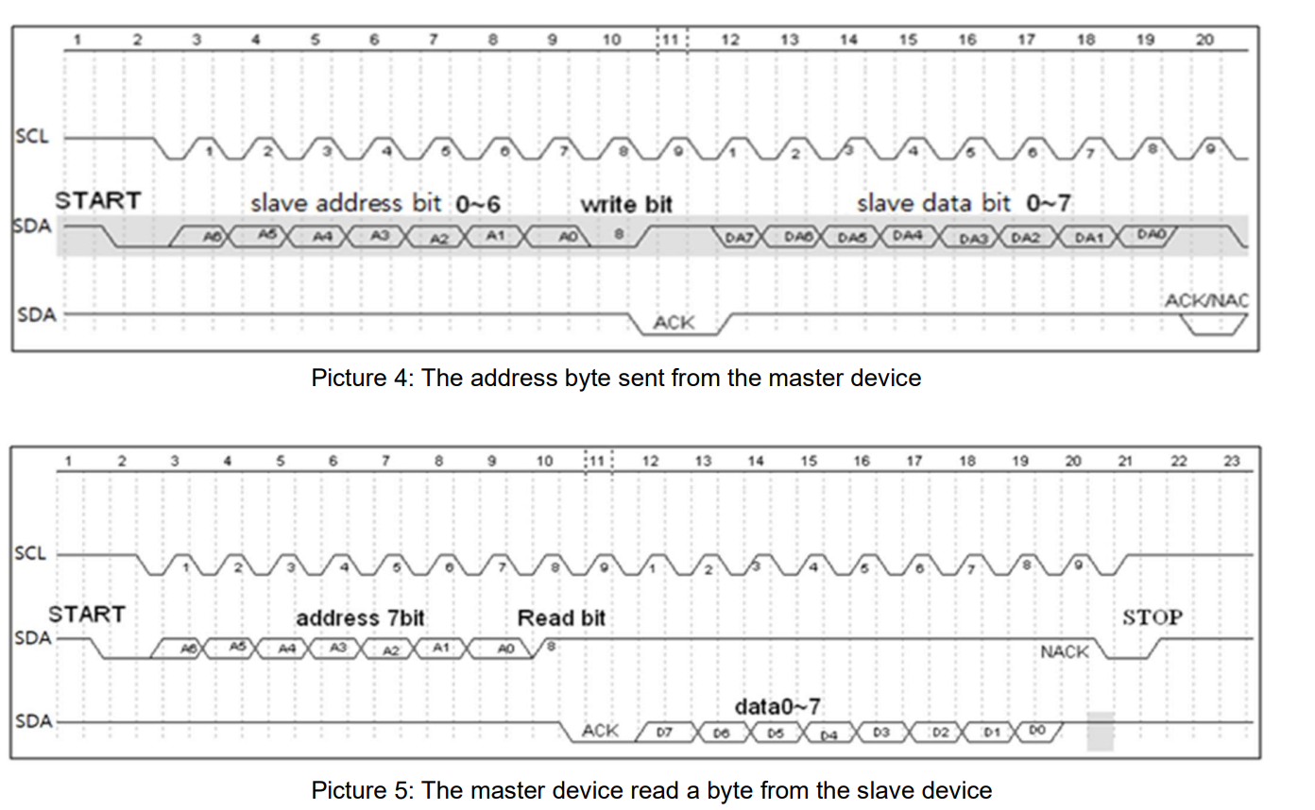

Slide 12
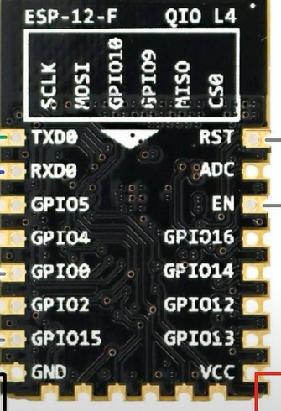
D
SCL
D1
D0/wake
SDA
D2
D5
D3
D6
D8/CS
LED/D4
D7
GND
3.3V

